Slide 1
Chapter 4
Control Structures
Er. Amrit poudel

Slide 2
Contents
Control Structures
Control Statement
Decision Making statements
Looping statements
Loop control statements

Slide 3
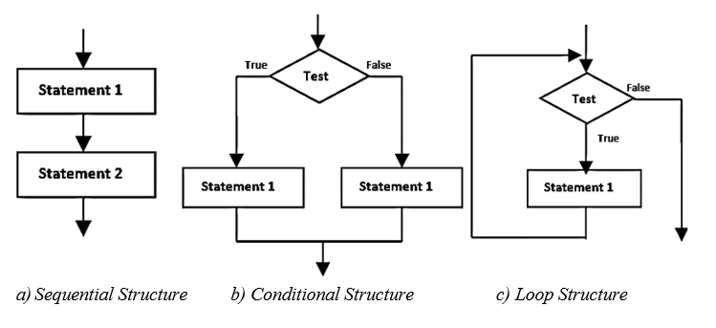
4.1 Control Structures
Control structure refers to the structure of program that may be sequential or conditional or iterative.

Slide 4
4.2 Control Statements
The statement that alters the flow of execution of the program is known as control statement.
These control statements divert the control flow from one point to another point in a program.
There are three types of control statements in C-programming.
Decision making statements (Conditional)
Loop statements
Jumping statements

Slide 5
4.2.1 Decision Making Statements
Such statements checks condition if TRUE or FALSE and then branch the executions
If statements
Switch statements
Ternary statements

Slide 6
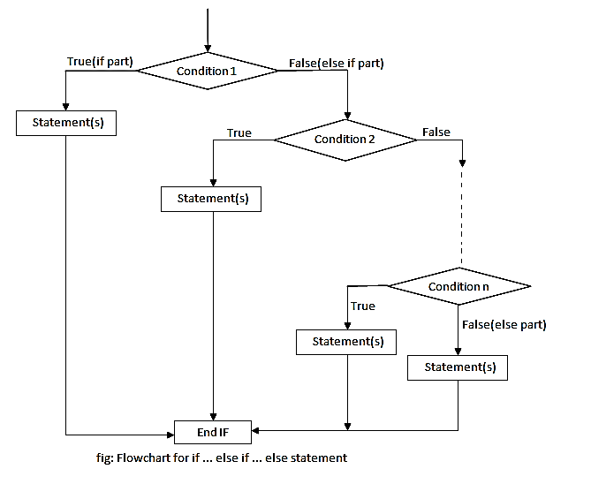
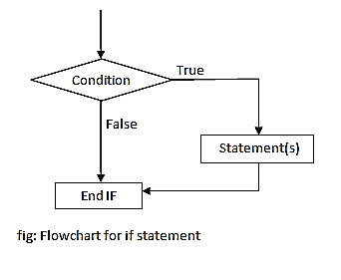
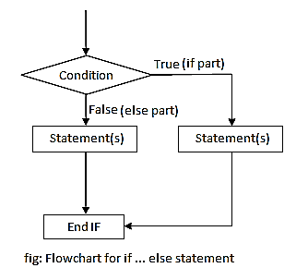
i) If statements
Simple if statement
if-else statement
if-else if- else statement

Slide 7
i) If statements
if-else if-else
statement
Simple if statement
if-else statement
if (test condition) { //statement 1; } else { //statement 2; }
if (condition 1) statement 1; else if (condition 2) statement 2; else if (condition 3) statement 3; else last statement;
if(condition)
{
//code to be executed
}

Slide 8
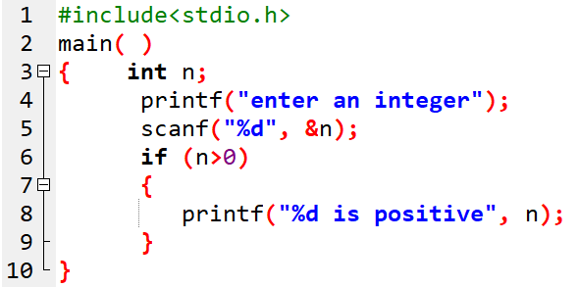

Prog 1. WAP to enter an integer and check if positive.

Slide 9
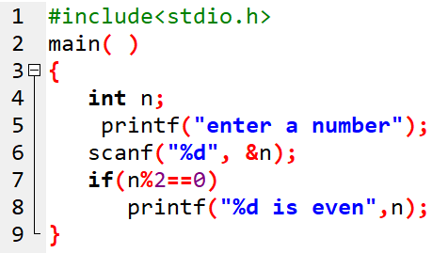

Prog 2. WAP to enter a number and check if it is even.

Slide 10
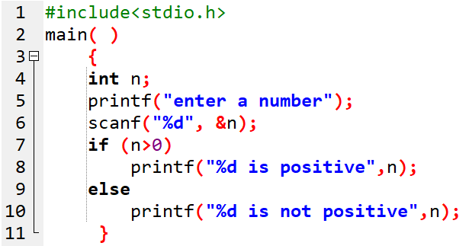


Prog 3. WAP to enter a number and check if it is positive or not positive.

Slide 11
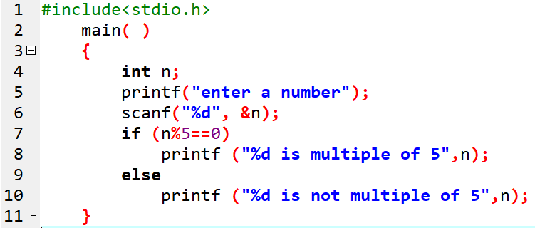

Prog 4. WAP to enter a number and check if it is multiple of 5 or not.

Slide 12
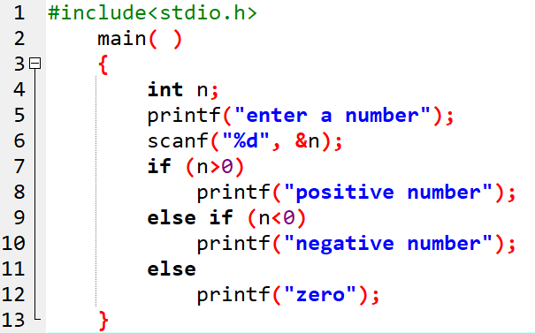



Prog 5. WAP to enter a number and check if positive, negative or zero.

Slide 13
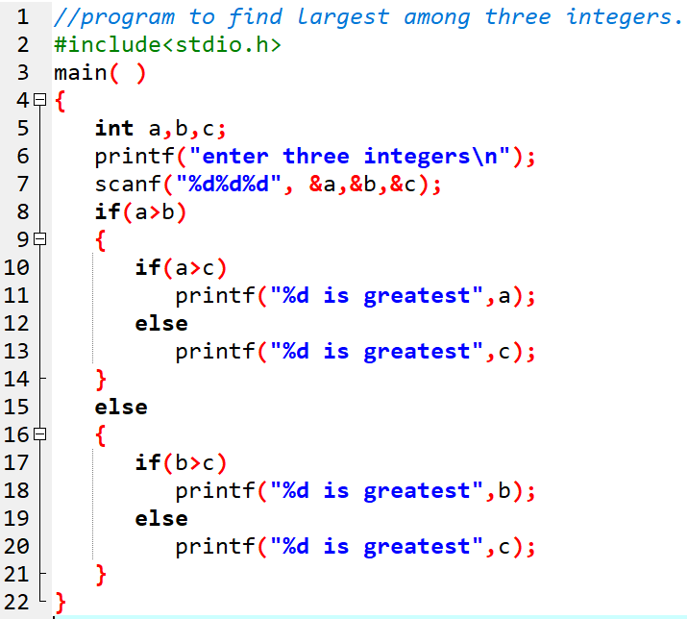
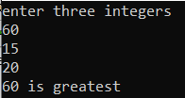
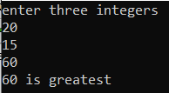
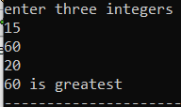
Prog 6. WAP to find the largest among three input integers.

Slide 14
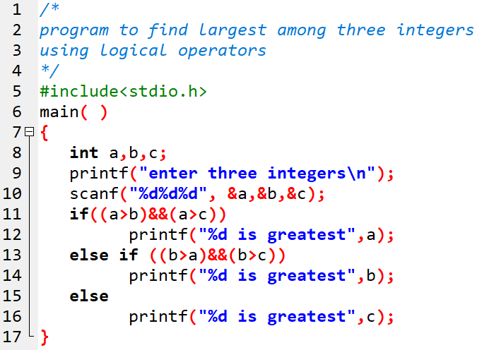
Prog 7. Using logical operators, WAP to find the greatest among three input numbers.

Slide 15
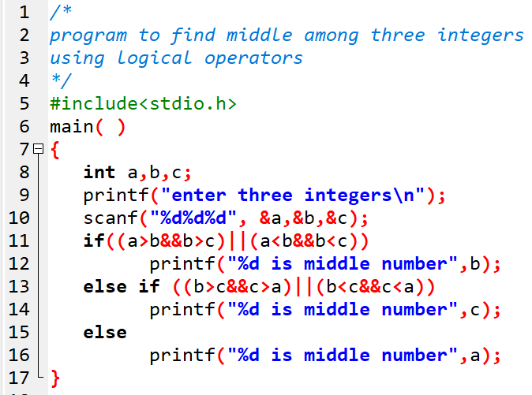
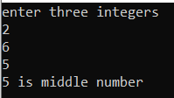
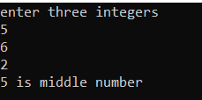
Prog 8. Using logical operators, WAP to find the middle one among three input numbers.

Slide 16
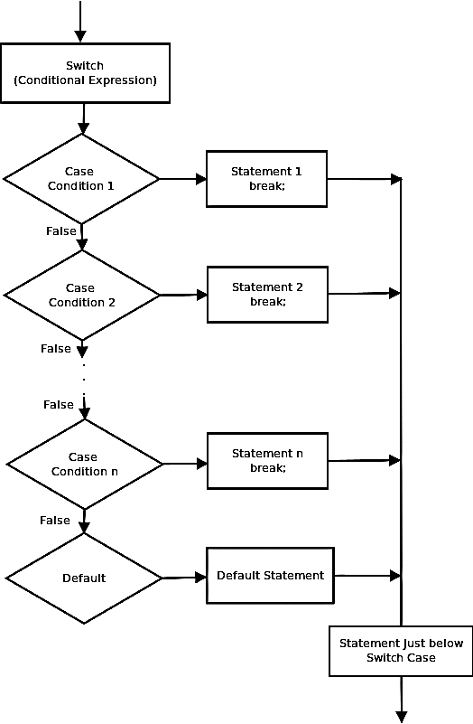
ii) Switch statement
Similar to if-else ladder
Tests for equality
Syntax:
switch (expression) { case value 1: statement block; break; case value 2: statement block; break; . . case value N: statement block; break; default: statement block; }

Slide 17
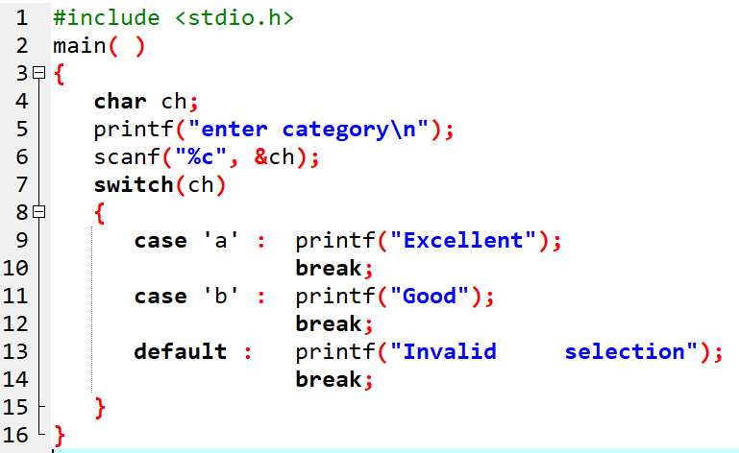

Prog 9. WAP to enter a character and display either excellent or good using switch statement.

Slide 18
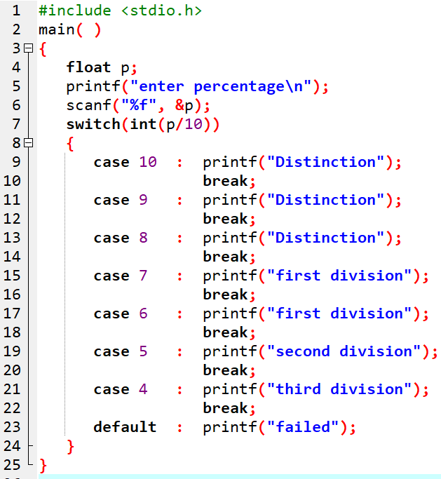

Prog 10. WAP to enter percentage of a student and display his division.

Slide 19
Assignment
WAP to display the following menu:
Menu
Conversion of ASCII code to char
To find the sum of n natural numbers
To find the greatest among two entered numbers.
Exit from program
and to perform task as per user’s choice repeatedly until his/her Choice is to exit.

Slide 20
iii) Ternary statement
uses ternary operators
Syntax:-
Conditional expression ? exp 1: exp 2;
If conditional expression is True:- exp 1 is evaluated.
If conditional expression is False:- exp 2 is evaluated.

Slide 21
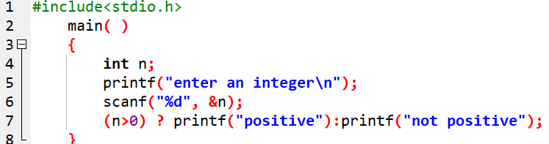

Prog 11. WAP to input an integer and check if positive or not. Make use of conditional operator.

Slide 22
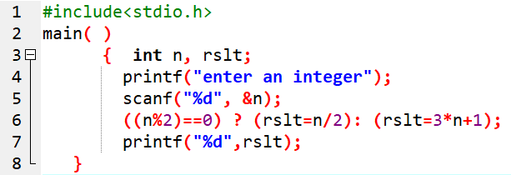

Prog 12. Using conditional operator, WAP to enter an integer and display the result as calculated below: Even:-n/2 Odd:-3n+1

Slide 23
4.2.2 Looping statements
Loop statements are the control statements that allow us to execute a block of statements repeatedly until a certain termination condition is met.
Three looping statements:
while loop
do-while loop
for loop

Slide 24
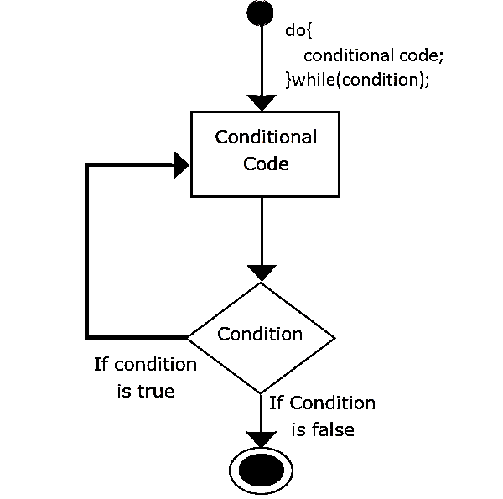
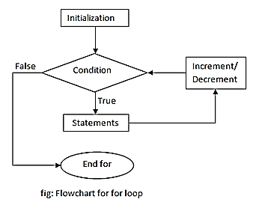
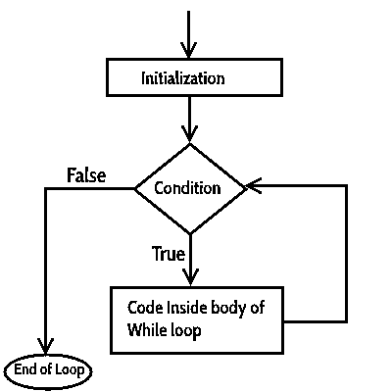
while loop
do-while loop
for loop
while (condition)
{
statements;
}
do
{
statement;
}while(condtion);
for(initialization; condition; increment/decrement)
{
statements;
}

Slide 25
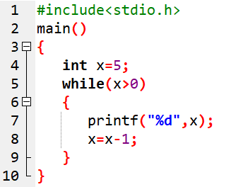
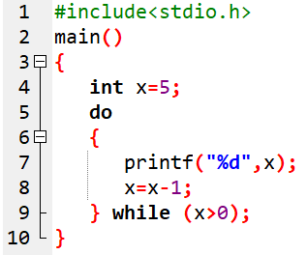
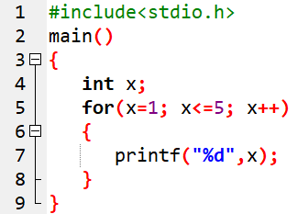
while loop
do-while loop
for loop

Slide 26
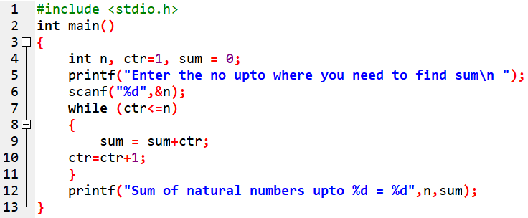

Prog 13. WAP to find the sum of N natural numbers using while loop.

Slide 27
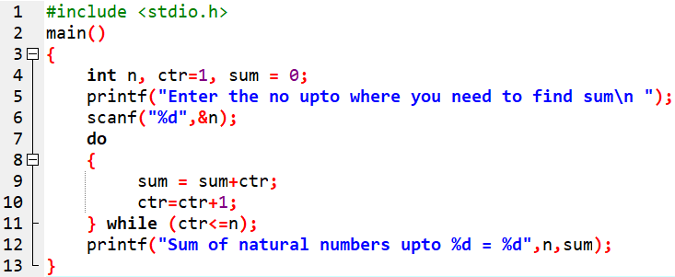

Prog 14. WAP to find the sum of N natural numbers using do-while loop.

Slide 28
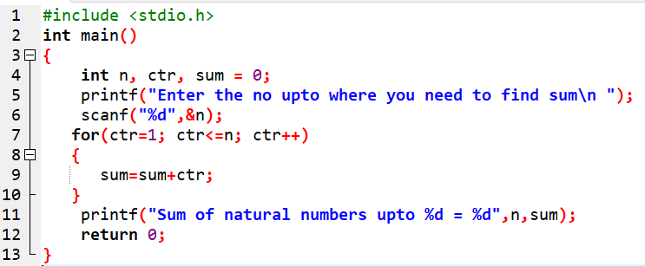

Prog 15. WAP to find the sum of N natural numbers using for loop.

Slide 29
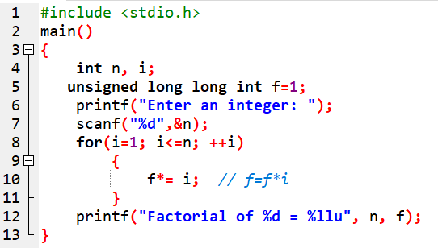

Prog 16. WAP to find the factorial of a given number.

Slide 30
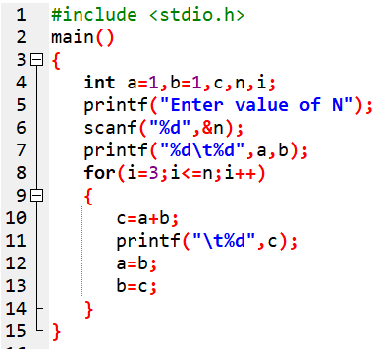

Prog 17. WAP to generate a Fibonacci series 1, 1, 2, 3, 5, 8, 13,…….n.

Slide 31
Loop control statement
These statements can control the continuous execution of the loop.
These are :
break,
continue
goto.

Slide 32
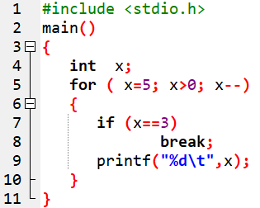
i) Break statement
When a break is encountered in a program,
remaining of the execution is terminated and
control is passed to out of the loop

Slide 33
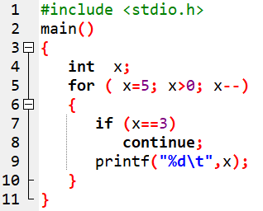

ii) Continue statement
Analyze this output:
Analysis: continue used to block certain loop and then continue onwards.

Slide 34
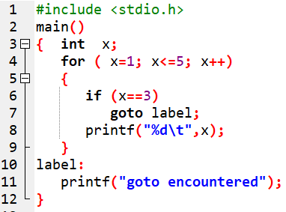
iii) Goto statement
When a goto statement is encountered in a loop,
the looping is terminated and
the control goes to the label specified by the goto statement.

Slide 35
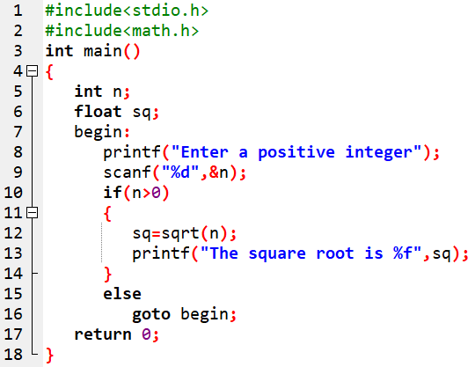

Prog 18. WAP using goto statement to find the square root of positive integer.

Slide 36
Assignment:
Differentiate between Entry-controlled loop and Exit-controlled loop in a tabular form.

Slide 37
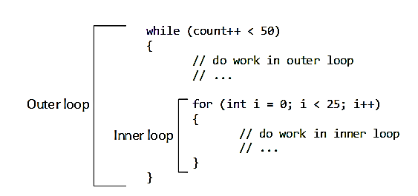
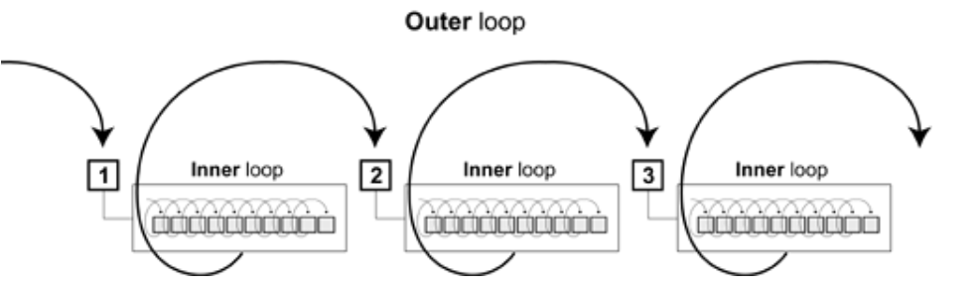
Nested Loop
Loop inside another loop
Outer loop called nesting loop
Inner loop called Nested loop

Slide 38
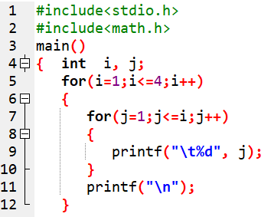
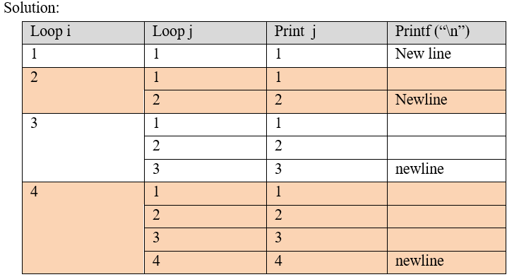
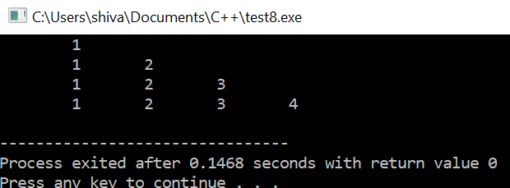
Trace the output of the below program:

Slide 39
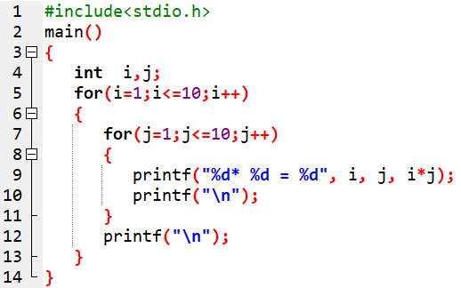
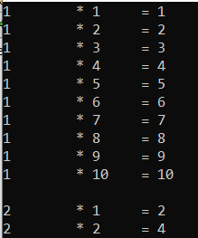
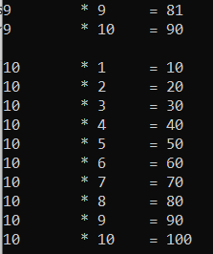
Prog 19. WAP to display the multiplication table of 1 to 10.

Slide 40
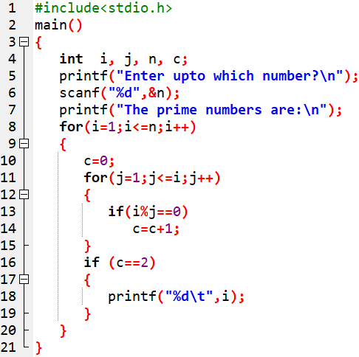

Prog 20. WAP to print all the prime numbers up to N number. Also draw the flowchart.

Slide 41
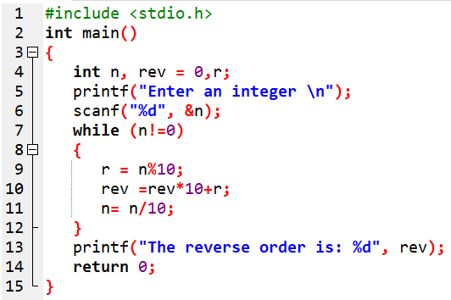

Prog 21. WAP to input an integer and print it in reverse order.

Slide 42
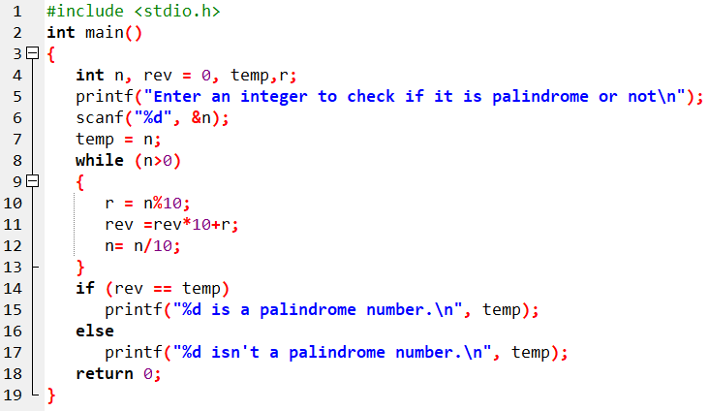

Prog 22. WAP to input an integer and check if it is palindrome or not.

Slide 43
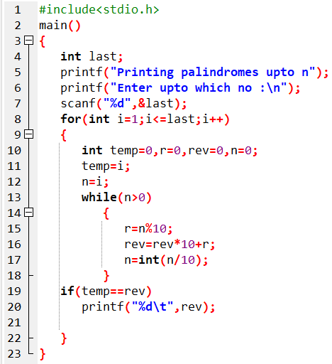

Prog 23. WAP to print all the palindrome numbers upto N.

Slide 44

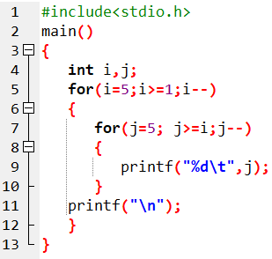
Prog 24. WAP to display the below pattern:

Slide 45
End of Chapter

